Slide 1
Mass Spectrometry
Introduction
General overview
Mass Spectrometry is the generation, separation and characterization of gas phase ions according to their relative mass as a function of charge
Previously, the requirement was that the sample be able to be vaporized (similar limitation to GC), but modern ionization techniques allow the study of such non-volatile molecules as proteins and nucleotides
The technique is a powerful qualitative and quantitative tool, routine analyses are performed down to the femtogram (10⁻¹⁵ g) level and as low as the zeptomole (10⁻²¹ mol) level for proteins
Of all the organic spectroscopic techniques, it is used by more divergent fields – metallurgy, molecular biology, semiconductors, geology, archaeology than any other

Slide 2
Mass Spectrometry
The Mass Spectrometer
General Schematic
A mass spectrometer needs to perform three functions:
Creation of ions – the sample molecules are subjected to a high energy beam of electrons, converting some of them to ions
Separation of ions – as they are accelerated in an electric field, the ions are separated according to mass-to-charge ratio (m/z)
Detection of ions – as each separated population of ions is generated, the spectrometer needs to qualify and quantify them
The differences in mass spectrometer types are in the different means to carry out these three functions
Common to all is the need for very high vacuum (~ 10⁻⁶ torr), while still allowing the introduction of the sample

Slide 3
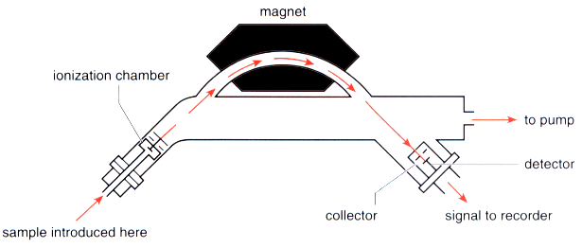
Mass Spectrometry
The Mass Spectrometer
Single Focusing Mass Spectrometer
A small quantity of sample is injected and vaporized under high vacuum
The sample is then bombarded with electrons having 25-80 eV of energy
A valence electron is “punched” off of the molecule, and an ion is formed

Slide 4
Mass Spectrometry
The Mass Spectrometer
The Single Focusing Mass Spectrometer
Ions (+) are accelerated using a (-) anode towards the focusing magnet
At a given potential (1 – 10 kV) each ion will have a kinetic energy:
½ mv² = eV
As the ions enter a magnetic field, their path is curved; the radius of the curvature is given by:
r = mv
eH
If the two equations are combined to factor out velocity:
m/e = H²r²
2V
m = mass of ion
v = velocity
V = potential difference
e = charge on ion
H = strength of magnetic field
r = radius of ion path

Slide 5
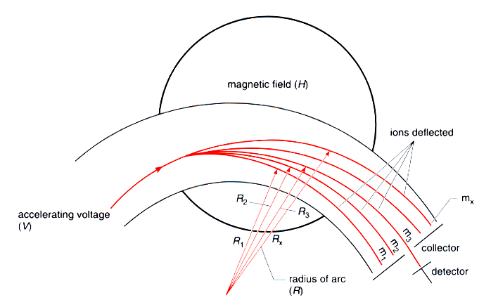
Mass Spectrometry
The Mass Spectrometer
Single Focusing Mass Spectrometer
At a given potential, only one mass would have the correct radius path to pass through the magnet towards the detector
“Incorrect” mass particles would strike the magnet

Slide 6
Mass Spectrometry
The Mass Spectrometer
Single Focusing Mass Spectrometer
By varying the applied potential difference that accelerates each ion, different masses can be discerned by the focusing magnet
The detector is basically a counter, that produces a current proportional to the number of ions that strike it
This data is sent to a computer interface for graphical analysis of the mass spectrum

Slide 7
Mass Spectrometry
The Mass Spectrometer
Double Focusing Mass Spectrometer
Resolution of mass is an important consideration for MS
Resolution is defined as R = M/ΔM, where M is the mass of the particle observed and ΔM is the difference in mass between M and the next higher particle that can be observed
Suppose you are observing the mass spectrum of a typical terpene (MW 136) and you would like to observe integer values of the fragments:
For a large fragment: R = 136 / (135 – 136) = 136
For a smaller fragment: R = 31 / (32 – 31) = 31
Even a low resolution instrument can produce R values of ~2000!
If higher resolution is required, the crude separation of ions by a single focusing MS can be further separated by a double-focusing instrument

Slide 8
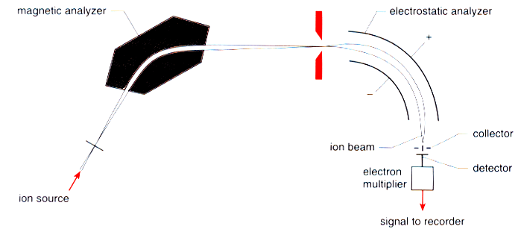
Mass Spectrometry
The Mass Spectrometer
Double Focusing Mass Spectrometer
Here, the beam of sorted ions from the focusing magnet are focused again by an electrostatic analyzer where the ions of identical mass are separated on the basis of differences in energy
The “cost” of increased resolution is that more ions are “lost” in the second focusing, so there is a decrease in sensitivity

Slide 9
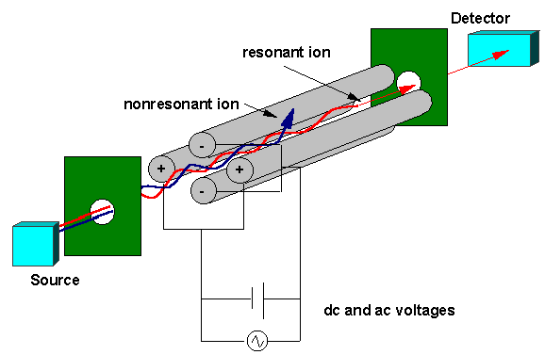
Mass Spectrometry
The Mass Spectrometer
Quadrupole Mass Spectrometer
Four magnets, hyperbolic in cross section are arranged as shown; one pair has an applied direct current, the other an alternating current
Only a particular mass ion can “resonate” properly and reach the detector
The advantage here is the compact size of the instrument – each rod is about the size of a ball-point pen

Slide 10
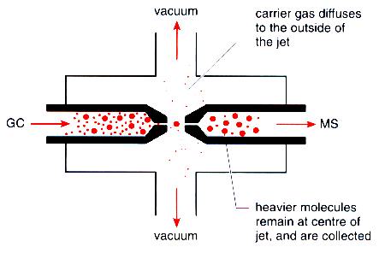
Mass Spectrometry
The Mass Spectrometer
Quadrupole Mass Spectrometer
The compact size and speed of the quadrupole instruments lends them to be efficient and powerful detectors for gas chromatography (GC)
Since the compounds are already vaporized, only the carrier gas needs to be eliminated for the process to take place
The interface between the GC and MS is shown; a “roughing” pump is used to evacuate the interface
Small He molecules are easily deflected from their flight path and are pulled off by the vacuum; the heavier ions, with greater momentum tend to remain at the center of the jet and are sent to the MS

Slide 11
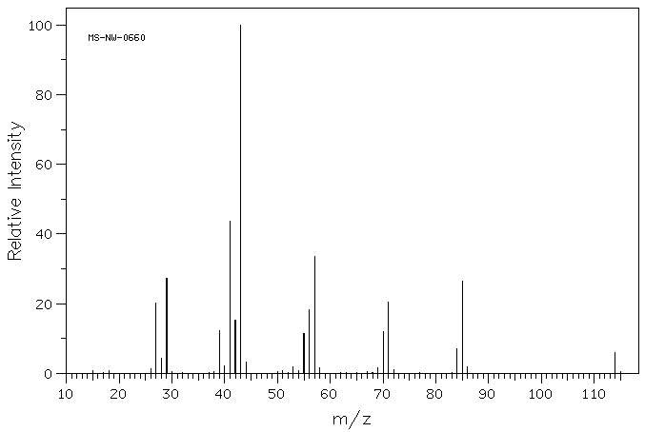
Mass Spectrometry
The Mass Spectrum
Presentation of data
The mass spectrum is presented in terms of ion abundance vs. m/e ratio (mass)
The most abundant ion formed in ionization gives rise to the tallest peak on the mass spectrum – this is the base peak
base peak, m/e 43

Slide 12
Mass Spectrometry
The Mass Spectrum
Presentation of data
All other peak intensities are relative to the base peak as a percentage
If a molecule loses only one electron in the ionization process, a molecular ion is observed that gives its molecular weight – this is designated as M⁺ on the spectrum
M⁺, m/e 114

Slide 13
Mass Spectrometry
The Mass Spectrum
Presentation of data
In most cases, when a molecule loses a valence electron, bonds are broken, or the ion formed quickly fragment to lower energy ions
The masses of charged ions are recorded as fragment ions by the spectrometer – neutral fragments are not recorded !
fragment ions

Slide 14
Mass Spectrometry
The Mass Spectrum
Determination of Molecular Mass
When a M+ peak is observed it gives the molecular mass – assuming that every atom is in its most abundant isotopic form
Remember that carbon is a mixture of 98.9% ¹²C (mass 12), 1.1% ¹³C (mass 13) and <0.1% ¹⁴C (mass 14)
We look at a periodic table and see the atomic weight of carbon as 12.011 – an average molecular weight
The mass spectrometer, by its very nature would see a peak at mass 12 for atomic carbon and a M + 1 peak at 13 that would be 1.1% as high
- We will discuss the effects of this later…

Slide 15
Mass Spectrometry
The Mass Spectrum
Determination of Molecular Mass
Some molecules are highly fragile and M+ peaks are not observed – one method used to confirm the presence of a proper M+ peak is to lower the ionizing voltage – lower energy ions do not fragment as readily
Three facts must apply for a molecular ion peak:
The peak must correspond to the highest mass ion on the spectrum excluding the isotopic peaks
The ion must have an odd number of electrons – usually a radical cation
The ion must be able to form the other fragments on the spectrum by loss of logical neutral fragments

Slide 16
Mass Spectrometry
The Mass Spectrum
Determination of Molecular Mass
The Nitrogen Rule is another means of confirming the observance of a molecular ion peak
If a molecule contains an even number of nitrogen atoms (only “common” organic atom with an odd valence) or no nitrogen atoms the molecular ion will have an even mass value
If a molecule contains an odd number of nitrogen atoms, the molecular ion will have an odd mass value
If the molecule contains chlorine or bromine, each with two common isotopes, the determination of M+ can be made much easier, or much more complex as we will see

Slide 17
Molecular Formulas – What can be learned from them
Remember and Review!
The Rule of Thirteen – Molecular Formulas from Molecular Mass – Lecture 1
When a molecular mass, M⁺, is known, a base formula can be generated from the following equation:
M = n + r
13 13
the base formula being: C_{n}H_{n} _{+ r}
For this formula, the HDI can be calculated from the following formula:
HDI = ( n – r + 2 )
2

Slide 18
Molecular Formulas – What can be learned from them
Remember and Review!
The Rule of Thirteen
The following table gives the carbon-hydrogen equivalents and change in HDI for elements also commonly found in organic compounds:
Element added | Subtract: | Δ HDI (ΔU in text) |  | Element added | Subtract: | Δ HDI (ΔU in text)
C | H₁₂ | 7 |  | ³⁵Cl | C₂H₁₁ | 3
H₁₂ | C | -7 |  | ⁷⁹Br | C₆H₇ | -3
O | CH₄ | 1 |  | F | CH₇ | 2
N | CH₂ | 1/2 |  | Si | C₂H₄ | 1
S | C₂H₈ | 2 |  | P | C₂H₇ | 2
 |  |  |  | I | C₉H₁₉ | 0

Slide 19
Mass Spectrometry
The Mass Spectrum
High Resolution Mass Spectrometry
If sufficient resolution (R > 5000) exists, mass numbers can be recorded to precise values (6 to 8 significant figures)
From tables of combinations of formula masses with the natural isotopic weights of each element, it is often possible to find an exact molecular formula from HRMS
Example: HRMS gives you a molecular ion of 98.0372; from mass 98 data:
C₃H₆N₄ 98.0594
C₄H₄NO₂ 98.0242
C₄H₆N₂O 98.0480
C₄H₈N₃ 98.0719
C₅H₆O₂ 98.0368 ← gives us the exact formula
C₅H₈NO 98.0606
C₅H₁₀N₂ 98.0845
C₇H₁₄ 98.1096

Slide 20
Mass Spectrometry
The Mass Spectrum and Structural Analysis
Inferences from Isotopic Ratios
If a M⁺ can be observed at sufficient intensity, information leading to a molecular formula can be attained
Consider ethane, C₂H₆ – on this mass spectrum a M⁺ ion would be observed at 30:
(2 x ¹²C) + (6 x ¹H) = 30
However, 1.08% of carbon is ¹³C – there is a 1.08% chance that either carbon in a bulk sample of ethane is ¹³C (2 x 1.08% or 2.16%)
In the mass spectrum we would expect to see a peak at 31 (one of the carbons being ¹³C) that was 2.16% of the intensity of the M⁺ signal - this is called the M+1 peak

Slide 21
Mass Spectrometry
The Mass Spectrum and Structural Analysis
Inferences from Isotopic Ratios
(cont.) Consider ethane, C₂H₆ – on this mass spectrum a M⁺ ion would be observed at 30:
There are also 6 hydrogens on ethane, ²H or deuterium is 0.016% of naturally occurring hydrogen – the chance that one of the hydrogens on ethane would be ²H is (6 x 0.016% = 0.096%)
If we consider this along with the ¹³C to give a increased probability of an M + 1 peak (31) we find (0.096% + 2.16% = 2.26%)
There is a small probability that both carbon atoms in some of the large number of ethane molecules in the sample are ¹³C – giving rise to a M+2 peak: (1.08% x 1.08%)/100 = 0.01% - negligible for such a small molecule
Many elements can contribute to M+1 and M+2 peaks with the contribution of the heavier isotopes

Slide 22
Mass Spectrometry
The Mass Spectrum and Structural Analysis
Inferences from Isotopic Ratios
Natural abundances of common elements and their isotopes – (relative abundance vs. a value of 100 for the most common isotope)
Element | Isotope M+1 | Relative abundance | Isotope M+2 | Relative abundance
¹H | ²H | 0.016
¹²C | ¹³C | 1.08
¹⁴N | ¹⁵N | 0.38
¹⁶O | ¹⁷O | 0.04 | ¹⁸O | 0.20
¹⁹F
²⁸Si | ²⁹Si | 5.10 | ³⁰Si | 3.35
³¹P
³²S | ³³S | 0.78 | ³⁴S | 4.40
³⁵Cl |  |  | ³⁷Cl | 32.5
⁷⁹Br |  |  | ⁸¹Br | 98.0
¹²⁷I

Slide 23
Mass Spectrometry
The Mass Spectrum and Structural Analysis
Inferences from Isotopic Ratios
To calculate the expected M+1 peak for a known molecular formula:
%(M+1) = 100 (M+1) = 1.1 x # of carbon atoms
M + 0.016 x # of hydrogen atoms
+ 0.38 x # of nitrogen atoms…etc.
Due to the typical low intensity of the M⁺ peak, one does not typically “back calculate” the intensity M+1 peak to attain a formula
However if it is observed, it can give a rough estimate of the number of carbon atoms in the sample:
Example: M⁺ peak at 78 has a M+1 at 79 that is 7% as intense:
#C x 1.1 = 7%
#C = 7%/1.1 = ~6

Slide 24
Mass Spectrometry
The Mass Spectrum and Structural Analysis
Inferences from Isotopic Ratios
For very large molecules the M+1, M+2, M+3… bands become very important
Consider this, if the # of carbon atoms in the molecule is over 100 the chance that there is one ¹³C is: 100 x 1.08% = 108%!
The M+2, 3, … peaks become even more prominent and molecules that contain nothing but the most common isotopes become rare!
M⁺
M+1
Here is the molecular ion peak(s) for a peptide containing 96 carbon atoms – note that the M+1 peak is almost as intense as the M⁺ peak
M+2
M+3

Slide 25
Mass Spectrometry
The Mass Spectrum and Structural Analysis
Inferences from Isotopic Ratios
For very large molecules the M+1, M+2, M+3… bands become very important
Remarkably, here is the molecular ion(s) of insulin (257 carbon atoms):
Odds are actually best that at least 3 carbon atoms are ¹³C
Molecules that are completely ¹²C are now rare

Slide 26
Mass Spectrometry
The Mass Spectrum and Structural Analysis
Inferences from Isotopic Ratios
For molecules that contain Cl or Br, the isotopic peaks are diagnostic
In both cases the M+2 isotope is prevalent:
³⁵Cl is 75.77% and ³⁷Cl is 24.23% of naturally occurring chlorine atoms
⁷⁹Br is 50.52% and ⁸¹Br is 49.48% of naturally occurring bromine atoms
If a molecule contains a single chlorine atom, the molecular ion would appear:
M⁺
The M+2 peak would be 24% the size of the M⁺
if one Cl is present
relative abundance
M+2
m/e

Slide 27
Mass Spectrometry
The Mass Spectrum and Structural Analysis
Inferences from Isotopic Ratios
For molecules that contain Cl or Br, the isotopic peaks are diagnostic
If a molecule contains a single bromine atom, the molecular ion would appear:
The effects of multiple Cl and Br atoms is additive – your text has a complete table of the combinations possible with 1-3 of either atom
Sulfur will give a M+2 peak of 4% relative intensity and silicon 3%
M⁺
M+2
The M+2 peak would be about the size of the M⁺
if one Br is present
relative abundance
m/e

Slide 28
Mass Spectrometry
The Mass Spectrum and Structural Analysis
Inferences from M⁺ - (A summary before moving on…)
If M⁺ is visible be sure to test for its validity:
The peak must correspond to the highest mass ion on the spectrum excluding the isotopic peaks
The ion must have an odd number of electrons – test with an HDI calculation
If the HDI is a whole number the ion is an odd-electron ion and therefore could be M⁺
If the HDI is not a whole number, it suggests that the ion is an even-electron ion and cannot be a molecular ion.
The ion must be able to form the other fragments on the spectrum by loss of logical neutral fragments

Slide 29
Mass Spectrometry
The Mass Spectrum and Structural Analysis
Inferences from M⁺ - (A summary before moving on…)
Using the the M⁺ peak, make any inferences about the approximate formula
Nitrogen Rule
Rule of Thirteen
HDI
Using the M+1 peak (if visible) make some inference as to the number of carbon atoms (for small molecules this works as H, N and O give very low contributions to M+1)
If M+2 becomes apparent, analyze for the presence of one or more Cl or Br atoms (sulfur and silicon can also give prominent M+2s)

Slide 30
Mass Spectrometry
The Mass Spectrum and Structural Analysis
Fragmentation - General
The collision of a high energy electron with a molecule not only causes the loss of a valence electron, it imparts some of the kinetic energy of collision into the remaining ion
This energy typically resides in an increased vibrational energy state for the molecule – this energy may be lost by the molecule breaking into fragments
The time between ionization and detection in most mass spectrometer is 10⁻⁵ sec.
If a particular ionized molecule can “hold together” for greater than 10⁻⁵ sec. a M⁺ ion is observed
If a particular ionized molecule fragments in less than this time, the fragments will be observed

Slide 31
Mass Spectrometry
The Mass Spectrum and Structural Analysis
Fragmentation - General
Due to the low concentration of molecules in the ionization chamber, all fragmentation processes are unimolecular
Fragmentation of a molecule that is missing one electron in most cases results in a covalent bond breaking homolytically – one fragment is then missing a full pair of electrons and has a + charge and the other fragment is a neutral radical
Only the + charged ions will be observed; but the loss of a neutral fragment is inferred by the difference of the M+ and the m/e of the fragment
Fragmentation will follow the trends you have learned in organic chemistry – fragmentation processes that lead to the most stable cations and radicals will occur with higher relative abundances

Slide 32
Mass Spectrometry
The Mass Spectrum and Structural Analysis
Fragmentation – Chemistry of Ions
One bond σ-cleavages:
cleavage of C-C
cleavage of C-heteroatom

Slide 33
Mass Spectrometry
The Mass Spectrum and Structural Analysis
Fragmentation – Chemistry of Ions
One bond σ-cleavages:
α-cleavage of C-heteroatom

Slide 34
Mass Spectrometry
The Mass Spectrum and Structural Analysis
Fragmentation – Chemistry of Ions
Two bond σ-cleavages/rearrangements:
Elimination of a vicinal H and heteroatom:
Retro-Diels-Alder
Full mechanism
Abbreviated:

Slide 35
Mass Spectrometry
The Mass Spectrum and Structural Analysis
Fragmentation – Chemistry of Ions
Two bond σ-cleavages/rearrangements:
McLafferty Rearrangement
Other types of fragmentation are less common, but in specific cases are dominant processes
These include: fragmentations from rearrangement, migrations, and fragmentation of fragments
Full mechanism
Abbreviated:

Slide 36
Mass Spectrometry
The Mass Spectrum and Structural Analysis
Fragmentation – Chemistry of Ions
When deducing any fragmentation scheme:
The even-odd electron rule applies: “thermodynamics dictates that even electron ions cannot cleave to a pair of odd electron fragments”
Mass losses of 14 are rare
The order of carbocation/radical stability is
benzyl/3° > allyl/2° > 1° > methyl > H
* the loss of the longest carbon chain is preferred
Fragment ion stability is more important than fragment radical stability
Fragmentation mechanisms should be in accord with the even-odd electron rule

Slide 37
Mass Spectrometry
The Mass Spectrum and Structural Analysis
Fragmentation Patterns of Groups
Aside: Some nomenclature – rather than explicitly writing out single bond cleavages each time:
Fragment obs. by MS
Neutral fragment inferred by its loss – not observed
Is written as:

Slide 38
Mass Spectrometry
The Mass Spectrum and Structural Analysis
Fragmentation Patterns of Groups
Alkanes
Very predictable – apply the lessons of the stability of carbocations (or radicals) to predict or explain the observation of the fragments
Method of fragmentation is single bond cleavage in most cases
This is governed by Stevenson’s Rule – the fragment with the lowest ionization energy will take on the + charge – the other fragment will still have an unpaired electron
Example: iso-butane

Slide 39
Mass Spectrometry
The Mass Spectrum and Structural Analysis
Fragmentation Patterns of Groups
Alkanes
Fragment Ions : n-alkanes
For straight chain alkanes, a M⁺ is often observed
Ions observed: clusters of peaks C_{n}H_{2n+1} apart from the loss of –CH₃, -C₂H₅, -C₃H₇, etc.
Fragments lost: ·CH₃, ·C₂H₅, ·C₃H₇, etc.
In longer chains – peaks at 43 and 57 are the most common

Slide 40
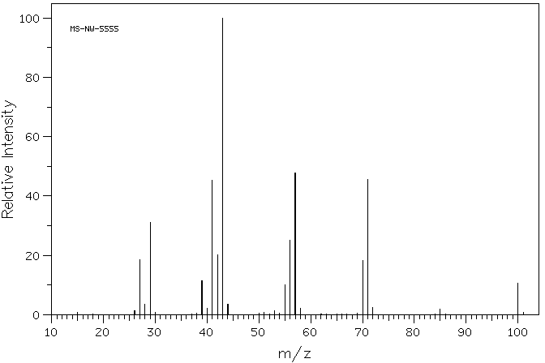
Mass Spectrometry
The Mass Spectrum and Structural Analysis
Fragmentation Patterns of Groups
Alkanes
Example MS: n-alkanes – n-heptane
M⁺

Slide 41
Mass Spectrometry
The Mass Spectrum and Structural Analysis
Fragmentation Patterns of Groups
Alkanes
Fragment Ions : branched alkanes
Where the possibility of forming 2° and 3° carbocations is high, the molecule is susceptible to fragmentation
Whereas in straight chain alkanes, a 1° carbocation is always formed, its appearance is of lowered intensity with branched structures
M+ peaks become weak to non-existent as the size and branching of the molecule increase
Peaks at 43 and 57 are the most common as these are the iso-propyl and tert-butyl cations

Slide 42
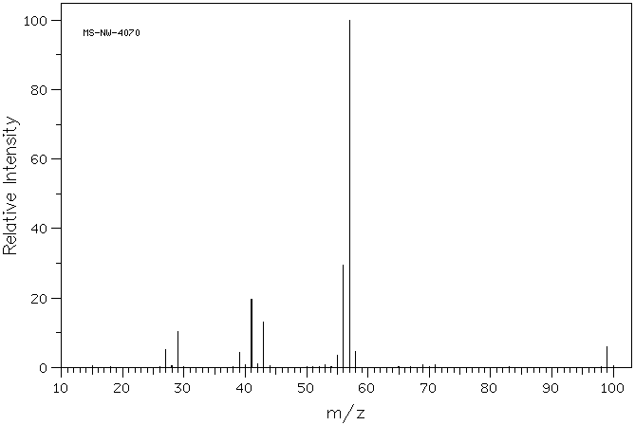
Mass Spectrometry
The Mass Spectrum and Structural Analysis
Fragmentation Patterns of Groups
Alkanes
Example MS: branched alkanes – 2,2-dimethylhexane
M⁺ 114

Slide 43
Mass Spectrometry
The Mass Spectrum and Structural Analysis
Fragmentation Patterns of Groups
Alkanes
Fragment Ions : cycloalkanes
Molecular ions strong and commonly observed – cleavage of the ring still gives same mass value
A two-bond cleavage to form ethene (C₂H₄) is common – loss of 28
Side chains are easily fragmented

Slide 44
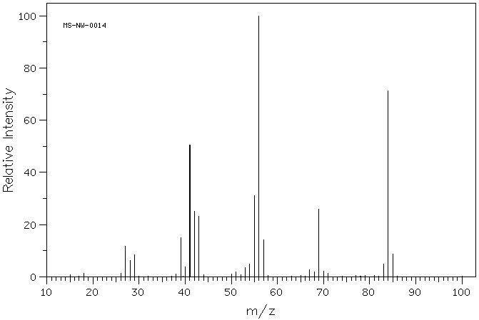
Mass Spectrometry
The Mass Spectrum and Structural Analysis
Fragmentation Patterns of Groups
Alkanes
Example MS: cycloalkanes – cyclohexane
M - 28 = 56
M⁺ 84

Slide 45
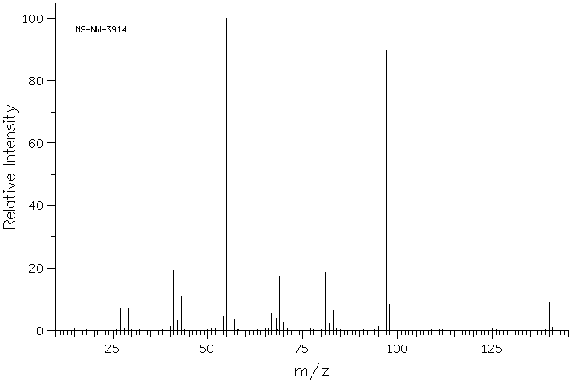
Mass Spectrometry
The Mass Spectrum and Structural Analysis
Fragmentation Patterns of Groups
Alkanes
Example MS: cycloalkanes – trans-p-menthane
M⁺ 140

Slide 46
Mass Spectrometry
The Mass Spectrum and Structural Analysis
Fragmentation Patterns of Groups
Alkenes
The π-bond of an alkene can absorb substantial energy – molecular ions are commonly observed
After ionization, double bonds can migrate readily – determination of isomers is often not possible
Ions observed: clusters of peaks C_{n}H_{2n-1} apart from -C₃H₅, -C₄H₇, -C₅H₉ etc. at 41, 55, 69, etc.
Terminal alkenes readily form the allyl carbocation, m/z 41

Slide 47
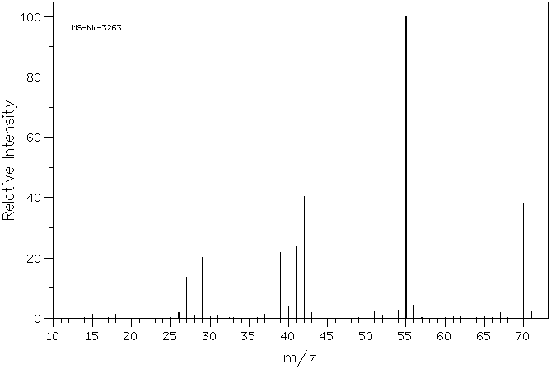
Mass Spectrometry
The Mass Spectrum and Structural Analysis
Fragmentation Patterns of Groups
Alkenes
Example MS: alkenes – cis- 2-pentene
M⁺ 70

Slide 48
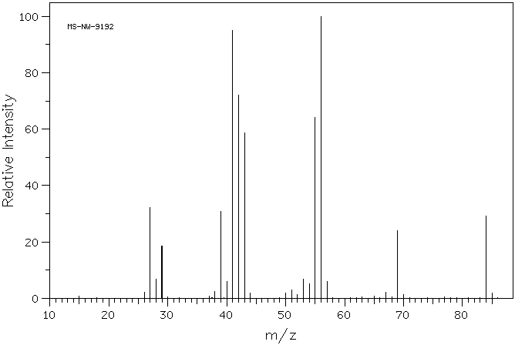
Mass Spectrometry
The Mass Spectrum and Structural Analysis
Fragmentation Patterns of Groups
Alkenes
Example MS: alkenes –1-hexene
Take home assignment:
What is M-42 and m/z 42?
M⁺ 84

Slide 49
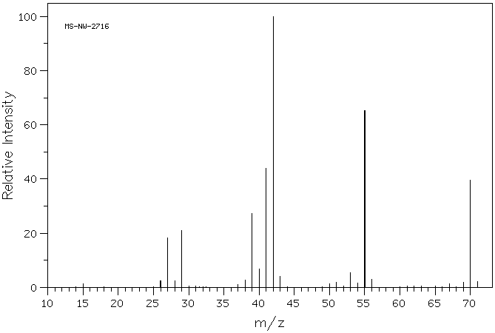
Mass Spectrometry
The Mass Spectrum and Structural Analysis
Fragmentation Patterns of Groups
Alkenes
Example MS: alkenes –1-pentene
Take home assignment 2:
What is m/z 42?
M⁺ 70

Slide 50
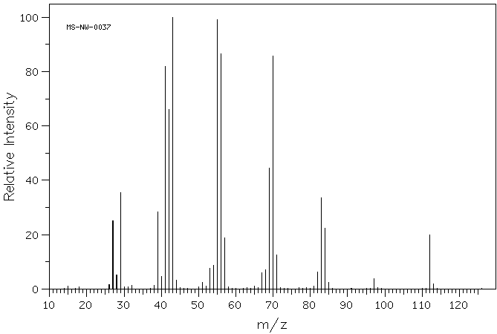
Mass Spectrometry
The Mass Spectrum and Structural Analysis
Fragmentation Patterns of Groups
Comparison: Alkanes vs. alkenes
Octane (75 eV)
M⁺ 114
m/z 85, 71, 57, 43 (base), 29
Octene (75 eV)
M⁺ 112 (stronger @ 75eV than octane)
m/z 83, 69, 55, 41, 29

Slide 51
Mass Spectrometry
The Mass Spectrum and Structural Analysis
Fragmentation Patterns of Groups
Alkenes
Fragment Ions : cycloalkenes
Molecular ions strong and commonly observed – cleavage of the ring still gives same mass value
Retro-Diels-Alder is significant
observed loss of 28
Side chains are easily fragmented

Slide 52
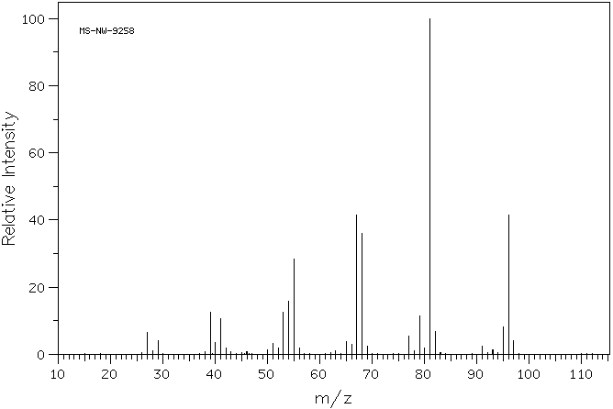
Mass Spectrometry
The Mass Spectrum and Structural Analysis
Fragmentation Patterns of Groups
Alkenes
Example MS: cycloalkenes –1-methyl-1-cyclohexene
68
M⁺ 96

Slide 53
Mass Spectrometry
The Mass Spectrum and Structural Analysis
Fragmentation Patterns of Groups
Alkynes – Fragment Ions
The π-bond of an alkyne can also absorb substantial energy – molecular ions are commonly observed
For terminal alkynes, the loss of terminal hydrogen is observed (M-1) – this may occur at such intensity to be the base peak or eliminate the presence of M⁺
Terminal alkynes form the propargyl cation, m/z 39 (lower intensity than the allyl cation)

Slide 54
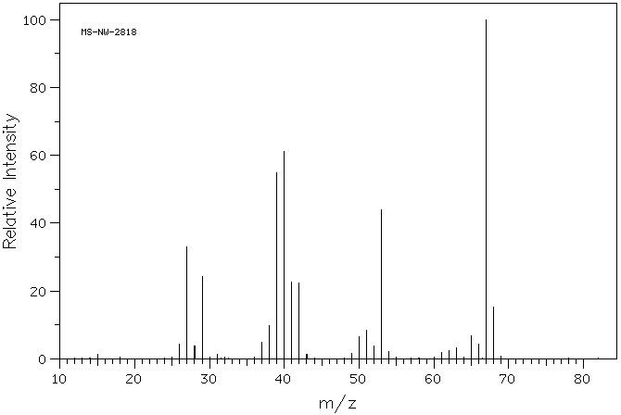
Mass Spectrometry
The Mass Spectrum and Structural Analysis
Fragmentation Patterns of Groups
Alkynes
Example MS: alkynes – 1-pentyne
M⁺ 68

Slide 55
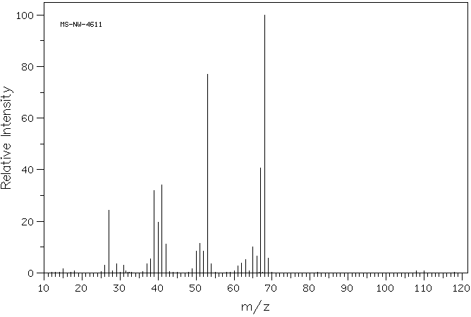
Mass Spectrometry
The Mass Spectrum and Structural Analysis
Fragmentation Patterns of Groups
Alkynes
Example MS: alkynes – 2-pentyne
M⁺ 68

Slide 56
Mass Spectrometry
The Mass Spectrum and Structural Analysis
Fragmentation Patterns of Groups
Aromatic Hydrocarbons – Fragment Ions
Very intense molecular ion peaks and little fragmentation of the ring system are observed
Where alkyl groups are attached to the ring, a favorable mode of cleavage is to lose a H-radical to form the C₇H₇⁺ ion (m/z 91)
This ion is believed to be the tropylium ion; formed from rearrangement of the benzyl cation

Slide 57
Mass Spectrometry
The Mass Spectrum and Structural Analysis
Fragmentation Patterns of Groups
Aromatic Hydrocarbons – Fragment Ions
If a chain from the aromatic ring is sufficiently long, a McLafferty rearrangement is possible
Substitution patterns for aromatic rings are able to be determined by MS – with the exception of groups that have other ion chemistry

Slide 58
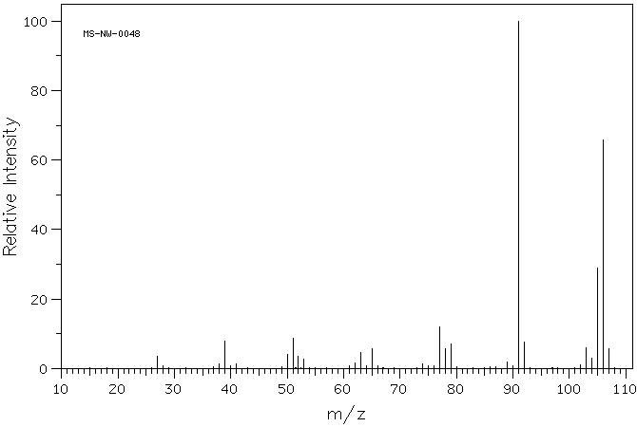
Mass Spectrometry
The Mass Spectrum and Structural Analysis
Fragmentation Patterns of Groups
Aromatic Hydrocarbons
Example MS: aromatic hydrocarbons – p-xylene
m/z 91
M⁺ 106

Slide 59
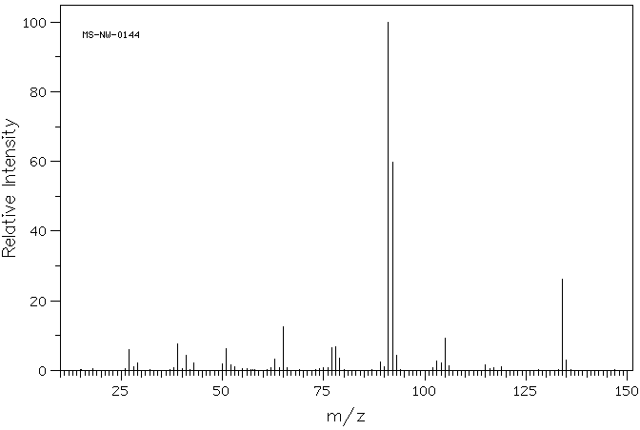
Mass Spectrometry
The Mass Spectrum and Structural Analysis
Fragmentation Patterns of Groups
Aromatic Hydrocarbons
Example MS: aromatic hydrocarbons – n -butylbenzene
92
M⁺ 134

Slide 60
Mass Spectrometry
The Mass Spectrum and Structural Analysis
Fragmentation Patterns of Groups
Alcohols– Fragment Ions
Additional modes of fragmentation will cause lower M⁺ than for the corresponding alkanes
1° and 2° alcohols have a low M⁺, 3° may be absent
The largest alkyl group is usually lost; the mode of cleavage typically is similar for all alcohols:
primary
secondary
tertiary
m/z
31
45
59

Slide 61
Mass Spectrometry
The Mass Spectrum and Structural Analysis
Fragmentation Patterns of Groups
Alcohols– Fragment Ions
Dehydration (M - 18) is a common mode of fragmentation – importance increases with alkyl chain length (>4 carbons)
1,2-elimination – occurs from hot surface of ionization chamber
1,4-elimination – occurs from ionization
both modes give M - 18, with the appearance and possible subsequent fragmentation of the remaining alkene
For longer chain alcohols, a McLafferty type rearrangement can produce water and ethylene (M - 18, M - 28)

Slide 62
Mass Spectrometry
The Mass Spectrum and Structural Analysis
Fragmentation Patterns of Groups
Alcohols– Fragment Ions
Loss of H is not favored for alkanols (M – 1)
Cyclic alcohols fragment by similar pathways
α-cleavage
dehydration
m/z 57
M - 18

Slide 63
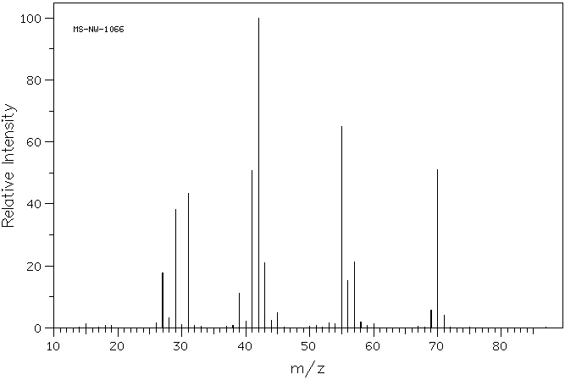
Mass Spectrometry
The Mass Spectrum and Structural Analysis
Fragmentation Patterns of Groups
Alcohols
Example MS: alcohols – n -pentanol
42
-H₂O
70
M⁺ 88

Slide 64
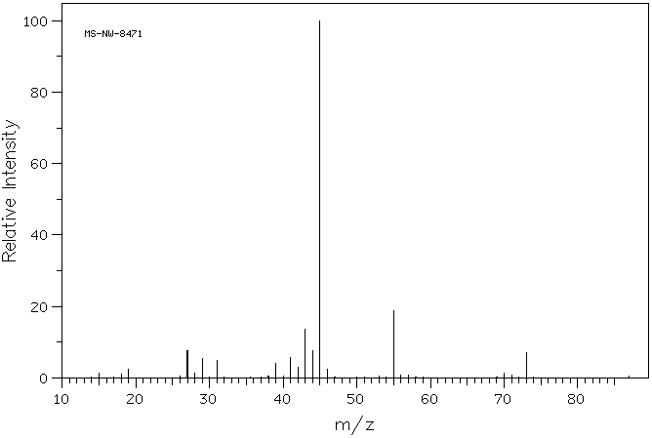
Mass Spectrometry
The Mass Spectrum and Structural Analysis
Fragmentation Patterns of Groups
Alcohols
Example MS: alcohols – 2-pentanol
M⁺ 88

Slide 65
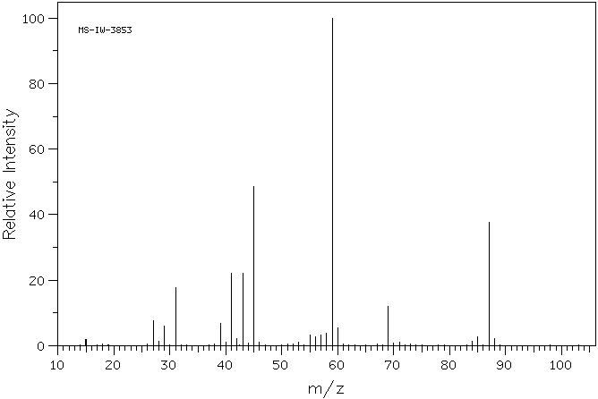
Mass Spectrometry
The Mass Spectrum and Structural Analysis
Fragmentation Patterns of Groups
Alcohols
Example MS: alcohols – 2-methyl-2-pentanol
M⁺ 102

Slide 66
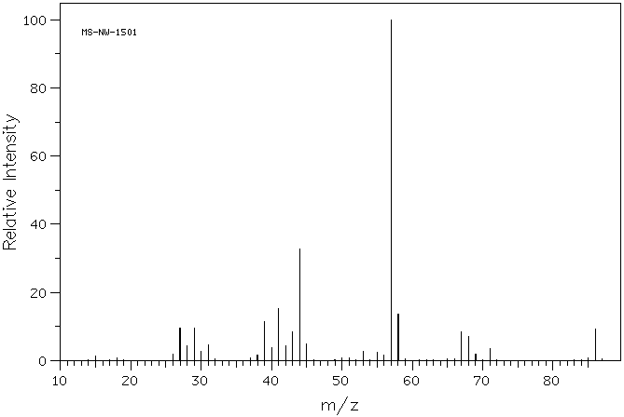
Mass Spectrometry
The Mass Spectrum and Structural Analysis
Fragmentation Patterns of Groups
Alcohols
Example MS: alcohols – cyclopentanol
57
M⁺ 86

Slide 67
Mass Spectrometry
The Mass Spectrum and Structural Analysis
Fragmentation Patterns of Groups
Phenols– Fragment Ions
Do not fully combine observations for aromatic + alcohol; treat as a unique group
For example, loss of H· is observed (M – 1) – charge can be delocalized by ring – most important for rings with EDGs
Loss of CO (extrusion) is commonly observed (M – 28); Net loss of the formyl radical (HCO·, M – 29) is also observed from this process

Slide 68
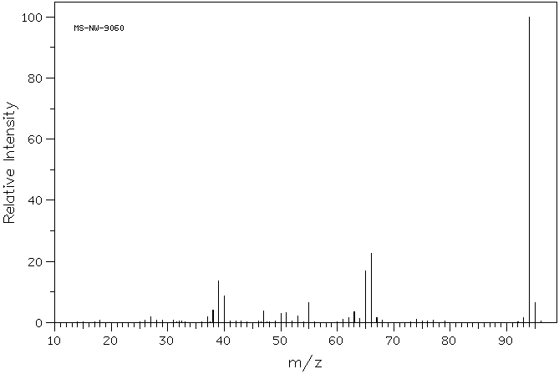
Mass Spectrometry
The Mass Spectrum and Structural Analysis
Fragmentation Patterns of Groups
Example MS: phenols – phenol
-CO 66
-HCO 65
M⁺ 94

Slide 69
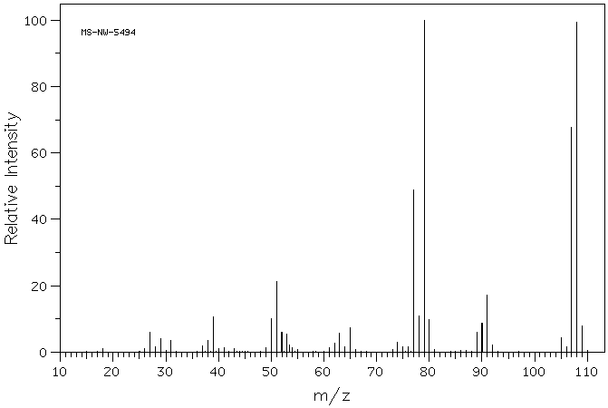
Mass Spectrometry
The Mass Spectrum and Structural Analysis
Fragmentation Patterns of Groups
An interesting combination of functionalities: benzyl alcohols
Upon ring expansion to tropylium ions, they become phenols!
M⁺ 108
“tropyliol” - CO
79
M – 1, 107
“tropyliol”
77

Slide 70
Mass Spectrometry
The Mass Spectrum and Structural Analysis
Fragmentation Patterns of Groups
Ethers– Fragment Ions
Slightly more intense M⁺ than for the corresponding alcohols or alkanes
The largest alkyl group is usually lost to α-cleavage; the mode of cleavage typically is similar to alcohols:
Cleavage of the C-O bond to give carbocations is observed where favorable

Slide 71
Mass Spectrometry
The Mass Spectrum and Structural Analysis
Fragmentation Patterns of Groups
Ethers– Fragment Ions
Rearrangement can occur of the following type, if α-carbon is branched:
Aromatic ethers, similar to phenols can generate the C₆H₅O⁺ ion by loss of the alkyl group rather than H; this can expel C≡O as in the phenolic degradation

Slide 72
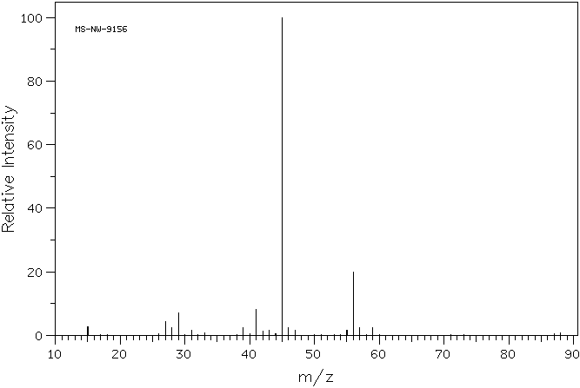
Mass Spectrometry
The Mass Spectrum and Structural Analysis
Fragmentation Patterns of Groups
Example MS: ethers – butyl methyl ether
M⁺ 88

Slide 73
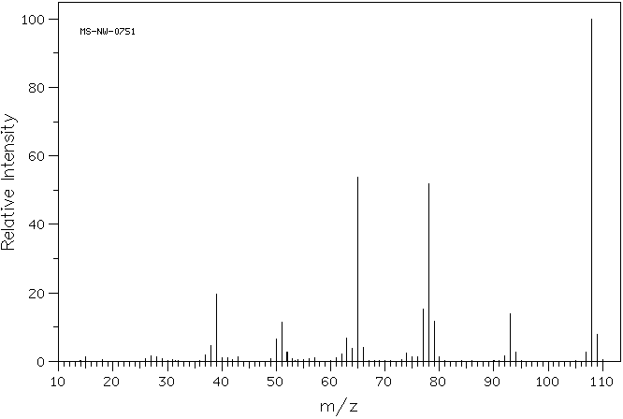
Mass Spectrometry
The Mass Spectrum and Structural Analysis
Fragmentation Patterns of Groups
Example MS: ethers – anisole
Take home – what is m/z 78?
M⁺ 108
M-28 (-CH₃, -CO)
65

Slide 74
Mass Spectrometry
The Mass Spectrum and Structural Analysis
Fragmentation Patterns of Groups
Aldehydes - Fragment Ions
Weak M⁺ for aliphatic, strong M⁺ for aromatic aldehydes
α-cleavage is characteristic and often diagnostic for aldehydes – can occur on either side of the carbonyl
β-cleavage is an additional mode of fragmentation
M-1 peak
m/z 29
m/z R⁺
M - 41
can be R-subs.

Slide 75
Mass Spectrometry
The Mass Spectrum and Structural Analysis
Fragmentation Patterns of Groups
Aldehydes - Fragment Ions
McLafferty rearrangement observed if γ-Hs present
Aromatic aldehydes – a-cleavages are more favorable, both to lose H· (M - 1) and HCO· (M – 29)
m/z 44
m/z R⁺
Remember: aromatic ring can be subs.

Slide 76
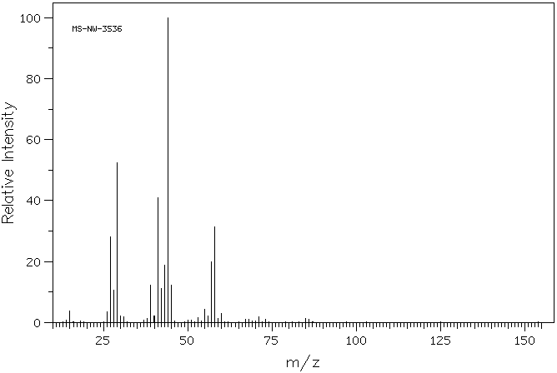
Mass Spectrometry
The Mass Spectrum and Structural Analysis
Fragmentation Patterns of Groups
Example MS: aldehydes (aliphatic) – pentanal
m/z 44
M-1
85
M⁺ 86

Slide 77
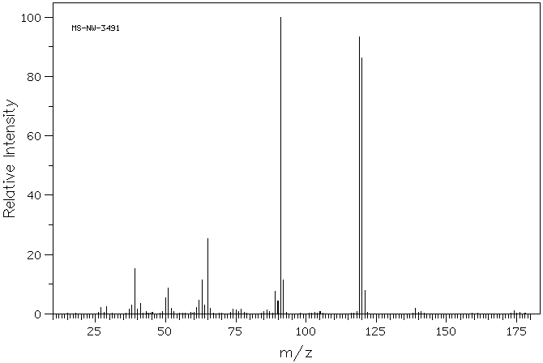
Mass Spectrometry
The Mass Spectrum and Structural Analysis
Fragmentation Patterns of Groups
Example MS: aldehydes (aromatic) – m-tolualdehyde
M-1
119
M⁺ 120

Slide 78
Mass Spectrometry
The Mass Spectrum and Structural Analysis
Fragmentation Patterns of Groups
Ketones - Fragment Ions
Strong M⁺ for aliphatic and aromatic ketones
α-cleavage can occur on either side of the carbonyl – the larger alkyl group is lost more often
β-cleavage is not as important of a fragmentation mode for ketones compared to aldehydes – but sometimes observed
M – 15, 29, 43…
m/z 43, 58, 72, etc.

Slide 79
Mass Spectrometry
The Mass Spectrum and Structural Analysis
Fragmentation Patterns of Groups
Ketones - Fragment Ions
McLafferty rearrangement observed if γ-H’s present – if both alkyl chains are sufficiently long – both can be observed
Aromatic ketones – α-cleavages are favorable primarily to lose R· (M – 15, 29…) to form the C₆H₅CO⁺ ion, which can lose C≡O
Remember: aromatic ring can be subs.

Slide 80
Mass Spectrometry
The Mass Spectrum and Structural Analysis
Fragmentation Patterns of Groups
Ketones - Fragment Ions
cyclic ketones degrade in a similar fashion to cycloalkanes and cycloalkanols:
m/z 55
m/z 70
m/z 42

Slide 81
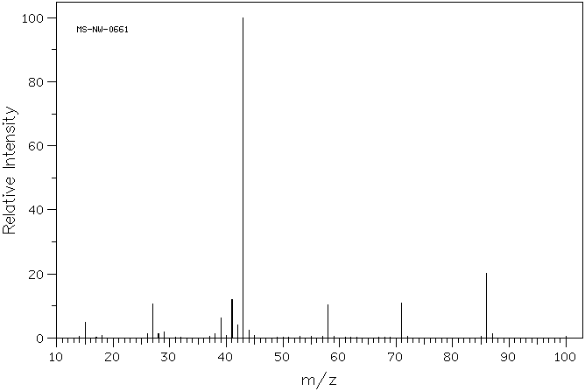
Mass Spectrometry
The Mass Spectrum and Structural Analysis
Fragmentation Patterns of Groups
Example MS: ketones (aliphatic) – 2-pentanone
M⁺ 86
M-15

Slide 82
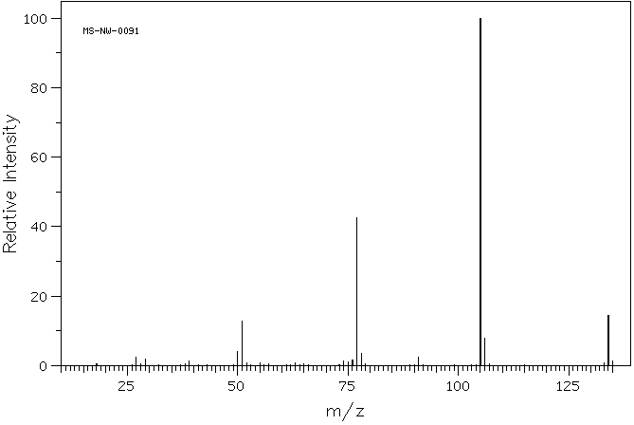
Mass Spectrometry
The Mass Spectrum and Structural Analysis
Fragmentation Patterns of Groups
Example MS: ketones (aromatic) – propiophenone
M⁺ 134

Slide 83
Mass Spectrometry
The Mass Spectrum and Structural Analysis
Fragmentation Patterns of Groups
Esters - Fragment Ions
M⁺ weak in most cases, aromatic esters give a stronger peak
Most important α-cleavage reactions involve loss of the alkoxy- radical to leave the acylium ion
The other α-cleavage (most common with methyl esters, m/z 59) involves the loss of the alkyl group

Slide 84
Mass Spectrometry
The Mass Spectrum and Structural Analysis
Fragmentation Patterns of Groups
Esters - Fragment Ions
McLafferty occurs with sufficiently long esters
Ethyl and longer (alkoxy chain) esters can undergo the McLafferty rearrangement

Slide 85
Mass Spectrometry
The Mass Spectrum and Structural Analysis
Fragmentation Patterns of Groups
Esters - Fragment Ions
The most common fragmentation route is to lose the alkyl group by α-cleavage, to form the C₆H₅CO⁺ ion (m/z 105)
Can lose CO to give m/z 77

Slide 86
Mass Spectrometry
The Mass Spectrum and Structural Analysis
Fragmentation Patterns of Groups
Esters - Fragment Ions
One interesting fragmentation is shared by both benzyloxy esters and aromatic esters that have an ortho-alkyl group
benzyloxy ester
ortho-alkylbenzoate ester

Slide 87
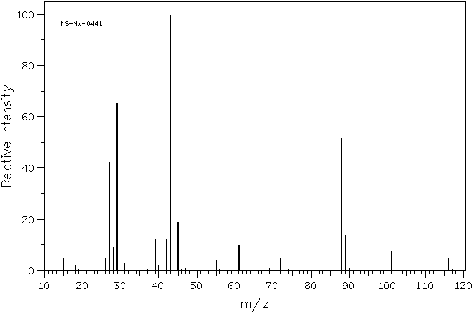
Mass Spectrometry
The Mass Spectrum and Structural Analysis
Fragmentation Patterns of Groups
Example MS: esters (aliphatic) – ethyl butyrate
both McLafferty (take home exercise)
m/z 88
M⁺ 116

Slide 88
Mass Spectrometry
The Mass Spectrum and Structural Analysis
Fragmentation Patterns of Groups
Example MS: esters (aliphatic) – ethyl butyrate
both McLafferty (take home exercise)
m/z 88
M⁺ 116

Slide 89
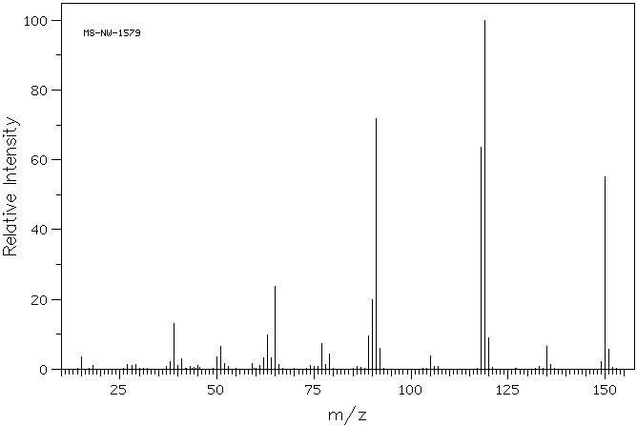
Mass Spectrometry
The Mass Spectrum and Structural Analysis
Fragmentation Patterns of Groups
Example MS: esters (benzoic) – methyl ortho-toluate
m/z 118
M⁺ 150

Slide 90
Mass Spectrometry
The Mass Spectrum and Structural Analysis
Fragmentation Patterns of Groups
Carboxylic Acids - Fragment Ions
As with esters, M⁺ weak in most cases, aromatic acids give a stronger peak
Most important α-cleavage reactions involve loss of the alkoxy- radical to leave the acylium ion
The other α-cleavage (less common) involves the loss of the alkyl radical. Although less common, the m/z 45 peak is somewhat diagnostic for acids.

Slide 91
Mass Spectrometry
The Mass Spectrum and Structural Analysis
Fragmentation Patterns of Groups
Carboxylic Acids - Fragment Ions
McLafferty occurs with sufficiently long acids
aromatic acids degrade by a process similar to esters, loss of the HO· gives the acylium ion which can lose C≡O:
m/z 60
+ further loss of CO to m/z 77

Slide 92
Mass Spectrometry
The Mass Spectrum and Structural Analysis
Fragmentation Patterns of Groups
Carboxylic Acids - Fragment Ions
As with esters, those benzoic acids with an ortho-alkyl group will lose water to give a ketene radical cation
ortho-alkylbenzoic acid

Slide 93
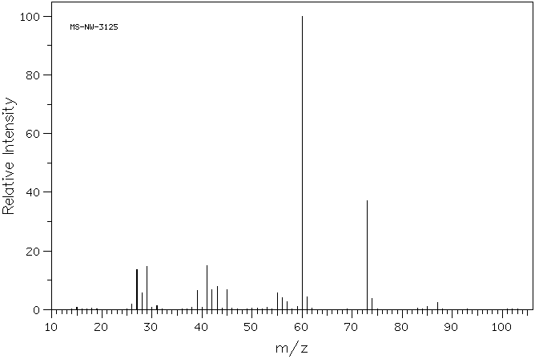
Mass Spectrometry
The Mass Spectrum and Structural Analysis
Fragmentation Patterns of Groups
Example MS: carboxylic acids (aliphatic) – pentanoic acid
m/z 60
M⁺ 102

Slide 94
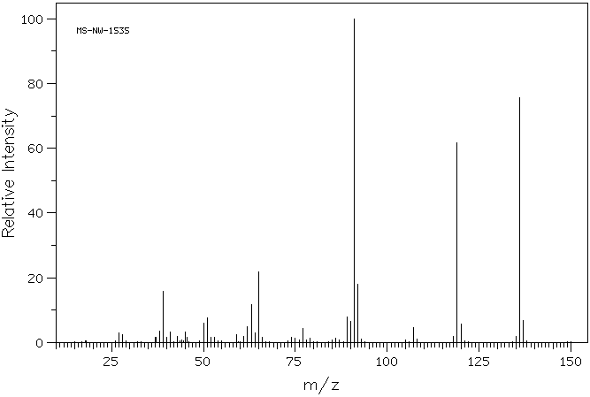
Mass Spectrometry
The Mass Spectrum and Structural Analysis
Fragmentation Patterns of Groups
Example MS: carboxylic acids (aromatic) – p-toluic acid
M⁺ 136

Slide 95
Mass Spectrometry
The Mass Spectrum and Structural Analysis
Fragmentation Patterns of Groups
Summary – Carbonyl Compounds
For carbonyl compounds – there are 4 common modes of fragmentation:
A₁ & A₂ -- two α-cleavages
B -- β-cleavage
C – McLafferty Rearrangement

Slide 96
Mass Spectrometry
The Mass Spectrum and Structural Analysis
Fragmentation Patterns of Groups
Summary – Carbonyl Compounds
In tabular format:
 |  | m/z of ion observed
Fragmentation | Path | Aldehydes G = H | Ketones G = R | Esters G = OR’ | Acids G = OH | Amides G = NH₂
A₁ α-cleavage | - R | 29 | 43^{b} | 59^{b} | 45 | 44^{d}
A₂ α-cleavage | - G | 43^{b} | 43^{b} | 43^{b} | 43^{b} | 43^{b}
B β-cleavage | - G | 43ª | 57^{b} | 73^{b} | 59ª | 58ª
C McLafferty |  | 44ª | 58^{b,c} | 74^{b,c} | 60ª | 59ª
^{b} = base, add other mass attached to this chain
ª = base, if α-carbon branched, add appropriate mass
^{c} = sufficiently long structures can undergo on either side of C=O
^{d} = if N-substituted, add appropriate mass

Slide 97
Mass Spectrometry
The Mass Spectrum and Structural Analysis
Fragmentation Patterns of Groups
Amines - Fragment Ions
Follow nitrogen rule – odd M⁺, odd # of nitrogens; nonetheless, M⁺ weak in aliphatic amines
α-cleavage reactions are the most important fragmentations for amines; for 1° n-aliphatic amines m/z 30 is diagnostic
McLafferty not often observed with amines, even with sufficiently long alkyl chains
Loss of ammonia (M – 17) is not typically observed

Slide 98
Mass Spectrometry
The Mass Spectrum and Structural Analysis
Fragmentation Patterns of Groups
Amines - Fragment Ions
Mass spectra of cyclic amines is complex and varies with ring size
Aromatic amines have intense M⁺
Loss of a hydrogen atom, followed by the expulsion of HCN is typical for anilines
Pyridines have similar stability (strong M⁺, simple MS) to aromatics, expulsion of HCN is similar to anilines

Slide 99
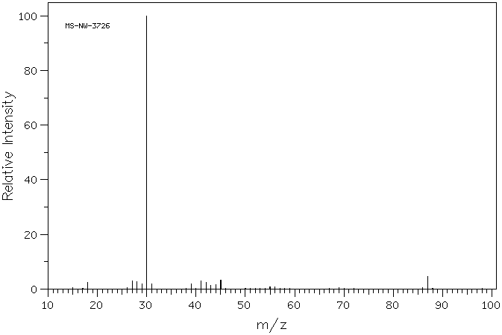
Mass Spectrometry
The Mass Spectrum and Structural Analysis
Fragmentation Patterns of Groups
Example MS: amines, 1° – pentylamine
M⁺ 87

Slide 100
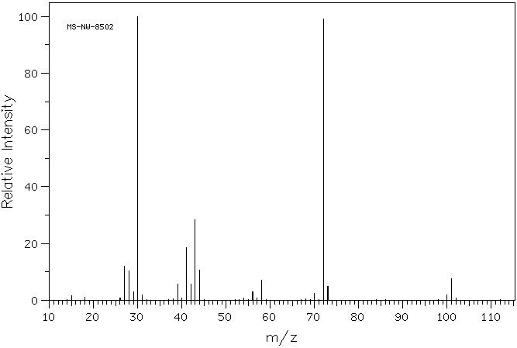
Mass Spectrometry
The Mass Spectrum and Structural Analysis
Fragmentation Patterns of Groups
Example MS: amines, 2° – dipropylamine
M⁺ 101

Slide 101
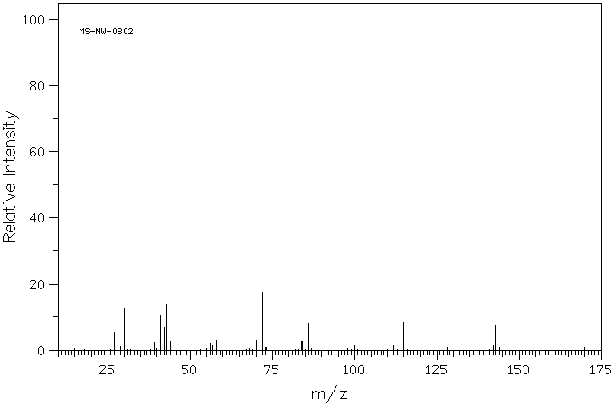
Mass Spectrometry
The Mass Spectrum and Structural Analysis
Fragmentation Patterns of Groups
Example MS: amines, 3° – tripropylamine
M⁺ 143

Slide 102
Mass Spectrometry
The Mass Spectrum and Structural Analysis
Fragmentation Patterns of Groups
Amides - Fragment Ions
Follow nitrogen rule – odd M⁺, odd # of nitrogens; observable M⁺
α-cleavage reactions afford a specific fragment of m/z 44 for primary amides
McLafferty observed where γ-hydrogens are present

Slide 103
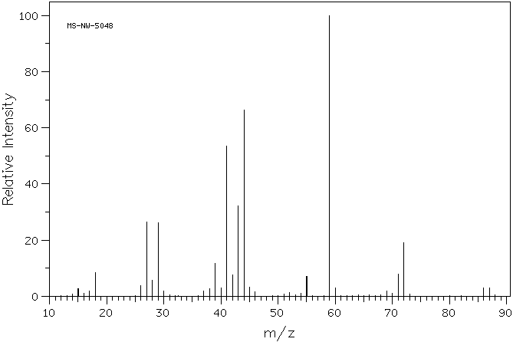
Mass Spectrometry
The Mass Spectrum and Structural Analysis
Fragmentation Patterns of Groups
Example MS: amides – butyramide
M⁺ 87

Slide 104
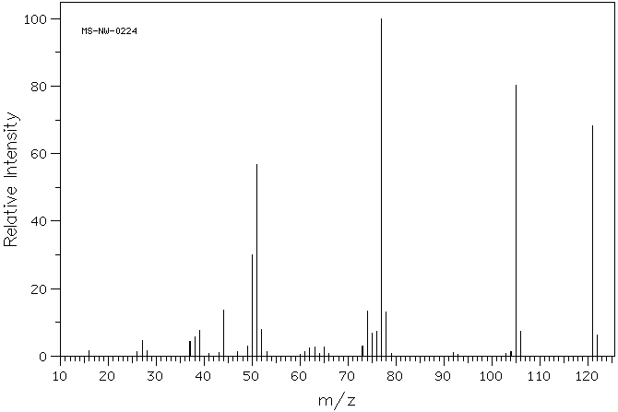
Mass Spectrometry
The Mass Spectrum and Structural Analysis
Fragmentation Patterns of Groups
Example MS: amides (aromatic) – benzamide
M⁺ 121

Slide 105
Mass Spectrometry
The Mass Spectrum and Structural Analysis
Fragmentation Patterns of Groups
Nitriles - Fragment Ions
Follow nitrogen rule – odd M⁺, odd # of nitrogens; weak M⁺
Principle degradation is the loss of an H-atom (M – 1) from α-carbon:
Loss of HCN observed (M – 27)
McLafferty observed where γ-hydrogens are present
Aromatic nitriles give a strong M⁺ as the strongest peak, loss of HCN is common (m/z 76) as opposed to loss of CN (m/z 77)

Slide 106
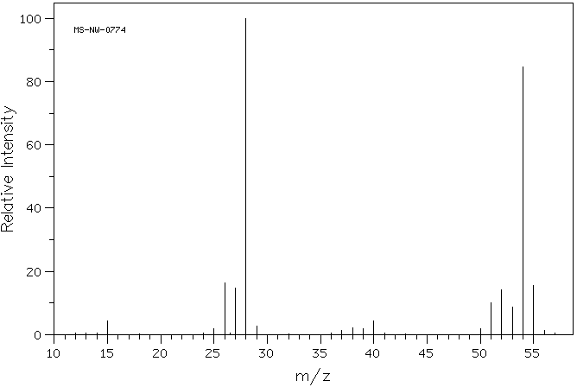
Mass Spectrometry
The Mass Spectrum and Structural Analysis
Fragmentation Patterns of Groups
Example MS: nitriles – propionitrile
M-1 54
- HC≡N
M⁺ 55

Slide 107
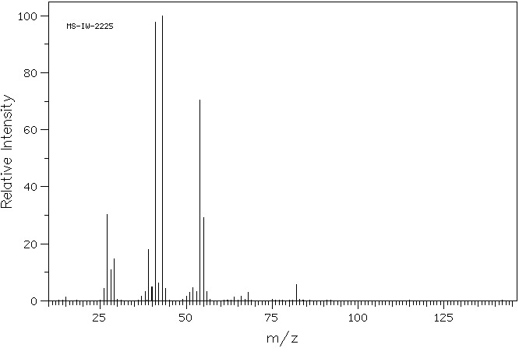
Mass Spectrometry
The Mass Spectrum and Structural Analysis
Fragmentation Patterns of Groups
Example MS: nitriles – valeronitrile (pentanenitrile)
M⁺ 83

Slide 108
Mass Spectrometry
The Mass Spectrum and Structural Analysis
Fragmentation Patterns of Groups
Nitro - Fragment Ions
Follow nitrogen rule – odd M⁺, odd # of nitrogens; M⁺ almost never observed, unless aromatic
Principle degradation is loss of NO⁺ (m/z 30) and NO₂⁺ (m/z 46)

Slide 109
Mass Spectrometry
The Mass Spectrum and Structural Analysis
Fragmentation Patterns of Groups
Nitro - Fragment Ions
Aromatic nitro groups show these peaks as well as the fragments of the loss of all or parts of the nitro group

Slide 110
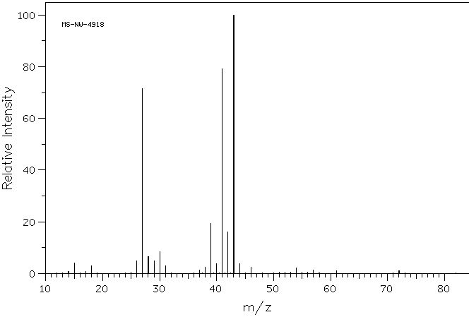
Mass Spectrometry
The Mass Spectrum and Structural Analysis
Fragmentation Patterns of Groups
Example MS: nitro – 1-nitropropane
NO⁺ 30
NO₂⁺ 46
M⁺ 89

Slide 111
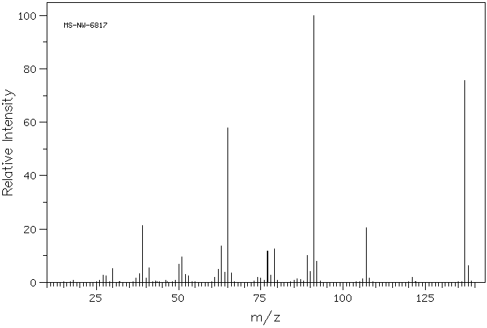
Mass Spectrometry
The Mass Spectrum and Structural Analysis
Fragmentation Patterns of Groups
Example MS: nitro (aromatic) – p-nitrotoluene
M⁺ 137
m/z 107

Slide 112
Mass Spectrometry
The Mass Spectrum and Structural Analysis
Fragmentation Patterns of Groups
Halogens - Fragment Ions
Halogenated compounds often give good M⁺
Fluoro- and iodo-compounds do not have appreciable contribution from isotopes
Chloro- and bromo-compounds are unique in that they will show strong M+2 peaks for the contribution of higher isotopes
For chlorinated compounds, the ratio of M⁺ to M+2 is about 3:1
For brominated compounds, the ratio of M⁺ to M+2 is 1:1
An appreciable M+4, 6, … peak is indicative of a combination of these two halogens – use appropriate guide to discern number of each

Slide 113
Mass Spectrometry
The Mass Spectrum and Structural Analysis
Fragmentation Patterns of Groups
Halogens - Fragment Ions
Principle fragmentation mode is to lose halogen atom, leaving a carbocation – the intensity of the peak will increase with cation stability
Leaving group ability contributes to the loss of halogen most strongly for -I and -Br less so for -Cl, and least for –F
Loss of HX is the second most common mode of fragmentation – here the conjugate basicity of the halogen contributes (HF > HCl > HBr > HI)

Slide 114
Mass Spectrometry
The Mass Spectrum and Structural Analysis
Fragmentation Patterns of Groups
Halogens - Fragment Ions
Less often, α-cleavage will occur:
For longer chain halides, the expulsion of a >δ carbon chain as the radical is observed
Aromatic halides give stronger M⁺, and typically lose the halogen atom to form C₆H₅⁺

Slide 115
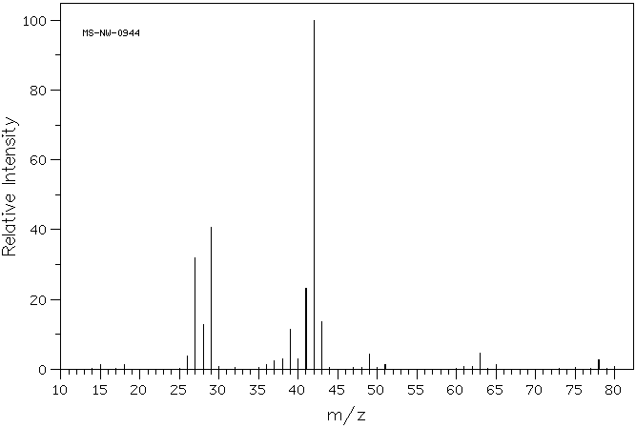
Mass Spectrometry
The Mass Spectrum and Structural Analysis
Fragmentation Patterns of Groups
Example MS: chlorine – 1-chloropropane
M+2
m/z 49, 51
M⁺ 78

Slide 116
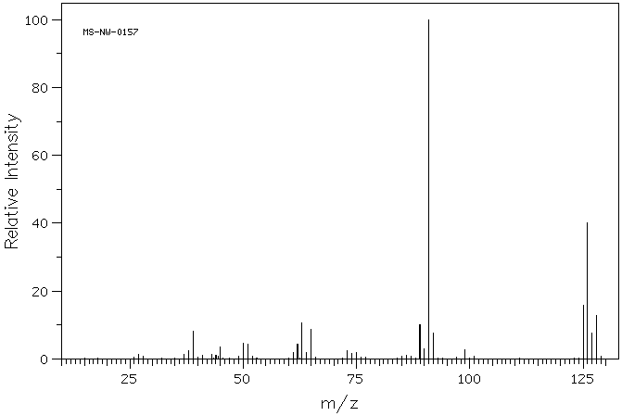
Mass Spectrometry
The Mass Spectrum and Structural Analysis
Fragmentation Patterns of Groups
Example MS: chlorine – p-chlorotoluene
M⁺ 126
M+2

Slide 117
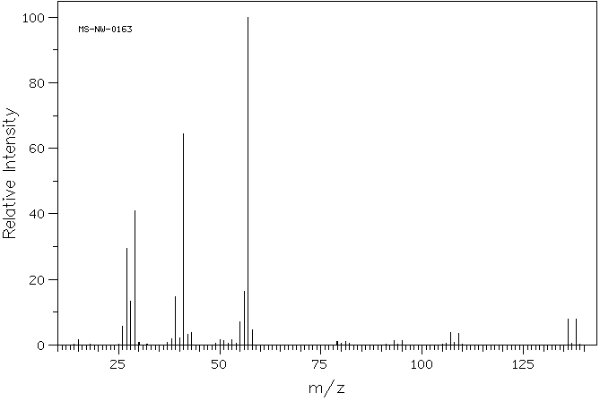
Mass Spectrometry
The Mass Spectrum and Structural Analysis
Fragmentation Patterns of Groups
Example MS: bromine – 1-bromobutane
M+2
M⁺ 136

Slide 118
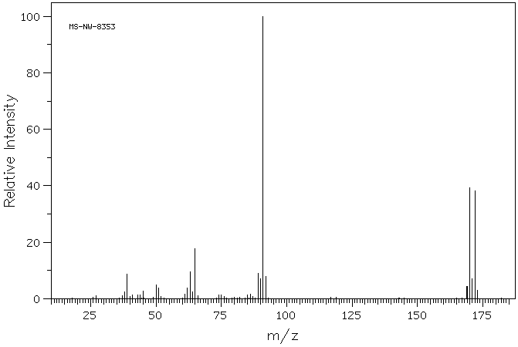
Mass Spectrometry
The Mass Spectrum and Structural Analysis
Fragmentation Patterns of Groups
Example MS: bromine – p-bromotoluene
M+2
M⁺ 170

Slide 119
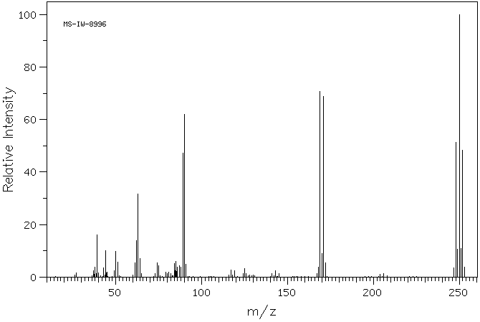
Mass Spectrometry
The Mass Spectrum and Structural Analysis
Fragmentation Patterns of Groups
Example MS: multiple bromines – 3,4-dibromotoluene
M+2
M+4
M⁺ 248

Slide 120
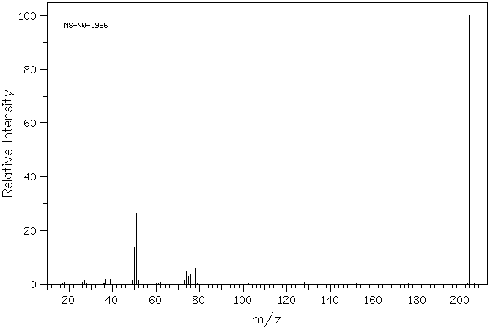
Mass Spectrometry
The Mass Spectrum and Structural Analysis
Fragmentation Patterns of Groups
Example MS: iodine – iodobenzene
M⁺ 204

Slide 121
Mass Spectrometry
The Mass Spectrum and Structural Analysis
Approach to analyzing a mass spectrum
As with IR, get a general feel for the spectrum before you analyze anything – is it simple, complex, groups of peaks, etc.
Squeeze everything you can out of the M⁺ peak that you can (once you have confirmed it is the M⁺)
Strong or Weak?
Isotopes? M+1? M+2, 4, …
Apply the Nitrogen rule
Apply the Rule of Thirteen to generate possible formulas (you can quickly dispose of possibilities based on the absence of isotopic peaks or the inference of the nitrogen rule)
Use the HDI from the Rule of Thirteen to further reduce the possibilities
Is there an M-1 peak?

Slide 122
Mass Spectrometry
The Mass Spectrum and Structural Analysis
Approach to analyzing a mass spectrum
Squeeze everything you can out of the base peak
What ions could give this peak? (m/z 43 doesn’t help much)
What was lost from M⁺ to give this peak?
When considering the base peak initially, only think of the most common cleavages for each group
Look for the loss of small neutral molecules from M⁺
H₂C=CH₂, HC≡CH, H₂O, HOR, HCN, HX
Now consider the possible diagnostic peaks on the spectrum (e.g.: 29, 30, 31, 45, 59, 77, 91, 105 etc.)
Lastly, once you have a hypothetical molecule that explains the data, see if you can verify it by use of other less intense peaks on the spectrum – not 100% necessary (or accurate) but if this step works it can add to the confidence level

Slide 123
Mass Spectrometry
End of material
Schedule:
Workshops: Friday Oct. 28th, Monday Oct. 31st, Wednesday Nov. 2nd (if needed).
Exam: Monday, November 7th (5 PM?); take home portion given out Friday, November 4th, due Wednesday, November 9th.
NMR material will begin Friday November 4th.
We will have lecture on Monday, November 7th (NMR)!
What’s left: Two NMR exams
– one in class, one take-home + Final are left 100, 100 and 125 pts.

